Slide 1
City of Sweetwater Sweetwater Recreation Complex
Local Parks and Recreation Fund Grant Application
January 19, 2023

Slide 2
Census Population and Dedicated Acreage of Recreation
2020 Census Sweetwater, TN Population: 6,312
Acreage dedicated to recreation: 40 acres

Slide 3
Targeted Demographics
z
Sweetwater Parks and Recreation intends for ALL persons to use and enjoy the proposed renovations to the pool and surrounding area including the track and pickleball/tennis courts.

Slide 4
ACTIVITIES/PROGRAMS
This project will involve the restoration of the existing Parks and Recreation facilities which includes the redevelopment of the existing pool, walking track, tennis courts, and providing new pickleball courts.
Programs provided with the help of this grant include: swimming lessons, water aerobics classes, parties by reservation, various adult and children sports leagues, etc.

Slide 5
POSITIVE COMMUNITY IMPACT AND GOALS
z
Sweetwater manages a variety of existing outdoor recreation facilities, however there are multiple areas in which each site needs rehabilitation. It is the goal of this project to provide both the necessary restoration of existing facilities, as well as the construction of new pickleball courts. Currently, while the facilities that Sweetwater Parks and Recreation already manages covers the needs of youth sports leagues and walking trails, there is a desire for more adult recreation opportunities. The new courts are designed as a remedy to the needs of Sweetwater citizens. The pool facility will become ADA compliant. Sweetwater has always strived to be at the forefront of recreation activities including a pickleball court as a potential spot for an adult recreation league.

Slide 6
Goal Areas and Potential Needs
The goal of the project is to continue to make improvements to the Recreation Sports Complex. This project will provide much needed improvements to ADA compliance access to the pool along with new outdoor recreation space for pickleball and other activities.
Sweetwater strives to provide the best amenities for its citizens. Sweetwater was featured in TravelMag.com in June 2022 and was identified as one of the most charming towns in Tennessee.

Slide 7
Funding
z
Total Budget: $756,000
Cash match of $358,000 will be provided by the Sweetwater General Fund to match $358,000 from TN Recreation funds.

Slide 8
Site Development
z
The project site is located on existing recreation space owned by the City of Sweetwater. This project will renovate the site of the existing pool and resurface the walking track and the tennis courts. An existing tennis court will be transformed into an active outdoor space for pickleball courts. The topography will remain the same as the existing conditions which is supportive of the proposed facilities.

Slide 9
Site Development
z

Slide 10
Future Development
z
The future site involves redevelopment of the existing pool facilities, resurfacing of the existing tennis courts, resurfacing of the existing walking track, and provision of pickleball courts.
Future programming will include additional swimming programs and pickleball programs and recreational leagues.

Slide 11
State Comprehensive Recreation Plan: Tennessee 2030
INCLUSIVITY, DIVERSITY, EQUITY, ACCESS, AFFORDABILITY: Goal: All Tennesseans will have access to and feel welcome at all local and state recreation facilities in which diversity is reflected in programs, operations, and staffing. Action #1—Ensure that all parks will be places where all communities can engage with nature in positive ways. The redevelopment of the pool with the addition of ADA compliant features will allow for people with disabilities to participate in swimming lessons and pool activities.

Slide 12
State Comprehensive Recreation Plan: Tennessee 2030
INCLUSIVITY, DIVERSITY, EQUITY, ACCESS, AFFORDABILITY: Goal: All Tennesseans will have access to and feel welcome at all local and state recreation facilities in which diversity is reflected in programs, operations, and staffing. Action #1—Ensure that all parks will be places where all communities can engage with nature in positive ways. The redevelopment of the pool with the addition of ADA compliant features will allow for people with disabilities to participate in swimming lessons and pool activities.
PARKS: Local Parks and Recreation: Sweetwater Recreation Complex gives consistent access to recreational services and provides close-to-home opportunities to enjoy recreation (open grassy fields, playground,), exercise (playground, pool, tennis pickleball), and interaction with nature.
PEOPLE: Public Health: Sweetwater actively encourages all residents to get outside and get moving. Sweetwater has a high rate of juvenile diabetes and percentage of obese/overweight residents. Improving the facilities at the park will encourage those same residents to be more of a participant in their community instead of just a spectator. There are lots of opportunities for all ages and abilities to be active to maintain their health.

Slide 13
3-year timeline
Summer 2023: Announcement of grant award
Fall/Winter of 2023: Signing of contract, environmental review, and submission of A&E plans
Spring 2024: Project out of bid and project awarded
Summer/Fall 2024: Breaking ground and construction
Winter 2024/2025: Complete project and closeout procedures

Slide 14
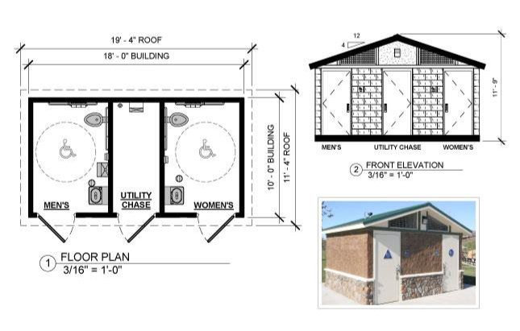
Project Design Elements
z

Slide 15
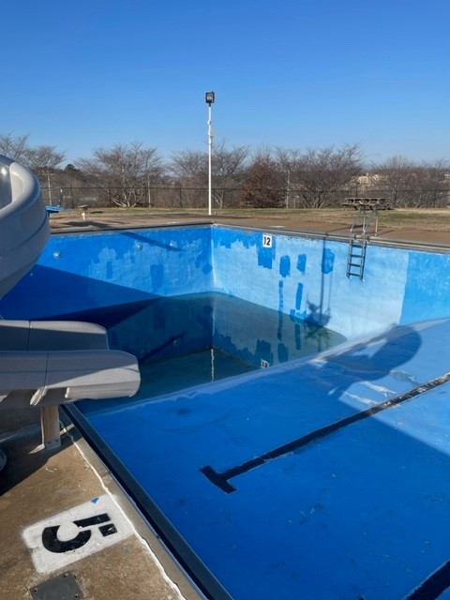
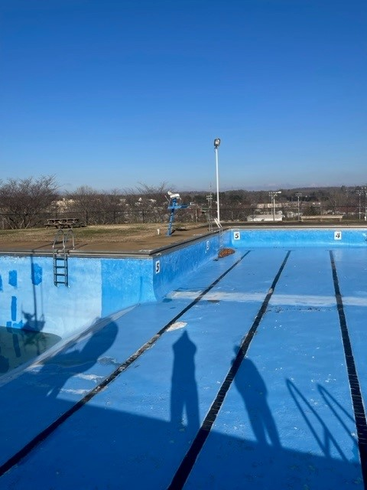
Pictures of Site

Slide 16
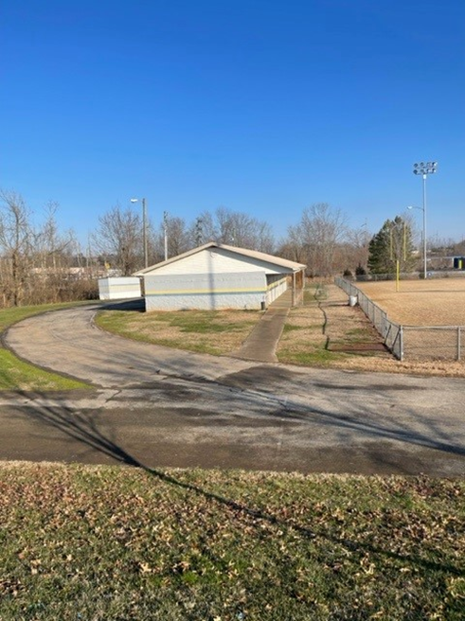
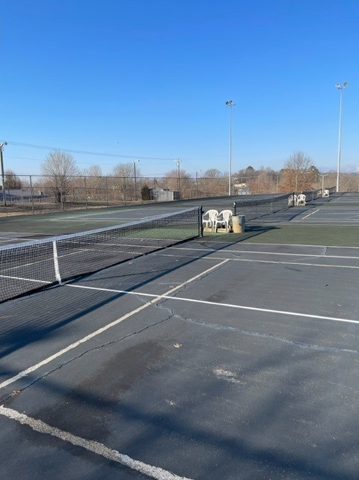
Pictures of Site

Slide 17
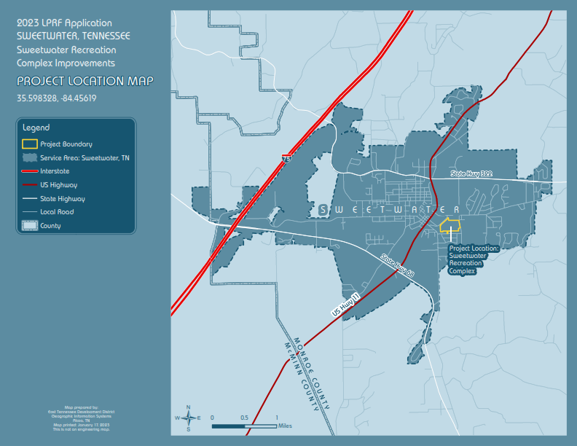
Project Location Map
z

Slide 18
Topographic Map
z

Slide 19
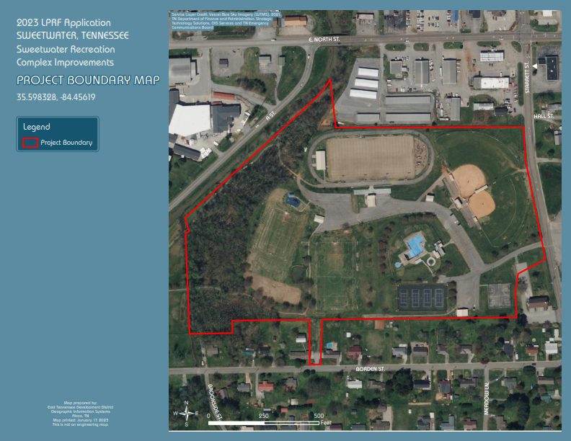
Project Boundary Map
z

Slide 20
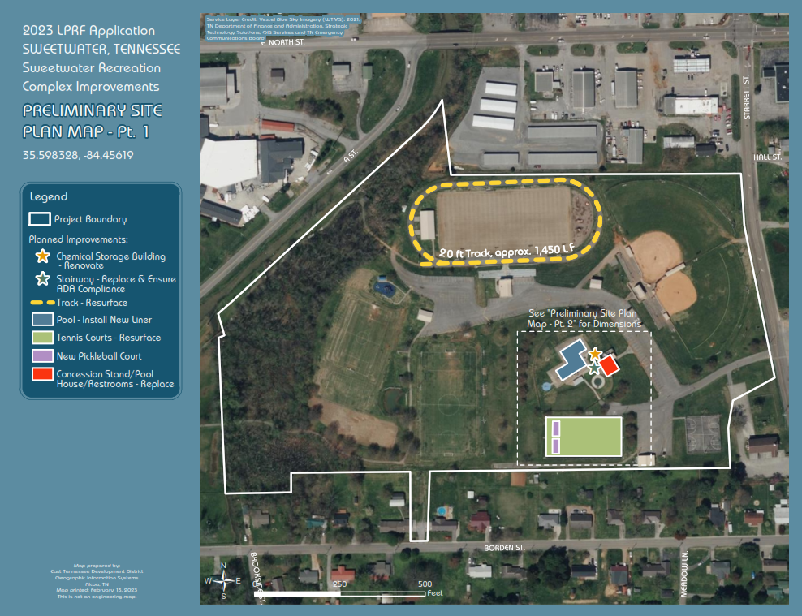
Preliminary Site Plan
Part 1
z

Slide 21
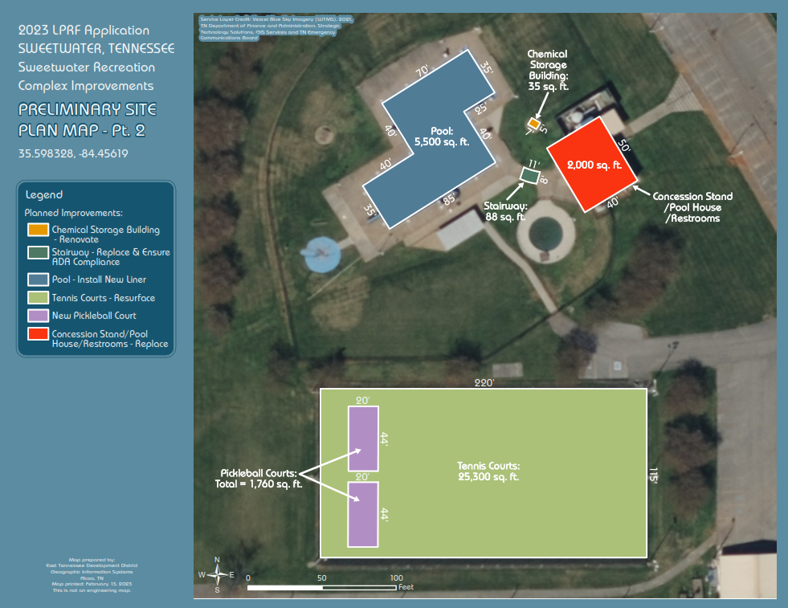
Preliminary Site Plan
Part 2
z

